Slide 1
Chapter 5
Consumer Markets and Consumer Buying Behavior

Slide 2
Consumer Buying Behavior
Consumer Buying Behavior refers to the buying behavior of final consumers -individuals & households who buy goods and services for personal consumption.
All these consumers make up the consumer market.
The central question for marketers is:
  “How do consumers respond to various marketing efforts the company might use?”

Slide 3
Model of Buyer Behavior (Fig. 5.1)
Marketing and
Other Stimuli
Marketing
Product
Price
Place
Promotion
Other
Economic
Technological
Political
Cultural
Buyer’s Black Box
Buyer Characteristics
Buyer Decision Process
Buyer Responses
Product Choice
Brand Choice
Dealer Choice
Purchase Timing
Purchase Amount

Slide 4

Factors Influencing
Consumer Behavior (Fig. 5.2)
Culture
Sub-
culture
Social
class
Cultural
Social
Reference
groups
Family
Roles
and
status
Personal
Age and
life-cycle
Occupation
Economic
situation
Lifestyle
Personality
and
self-concept
Psycho-
logical
Motivation
Perception
Learning
Beliefs and
attitudes
Buyer

Slide 5
Factors Affecting Consumer Behavior: Culture
Culture is the Most Basic Cause of a Person's Wants and Behavior.
Set of values norms, attitudes, and other meaningful symbols that shape human behavior and the artifacts, or products, of that behavior as they are transmitted from one generation to the next.
Subculture
Group of people with shared value systems based on common life experiences.
African American Consumers
Asian American Consumers

Slide 6


Factors Affecting Consumer Behavior: Culture
Culture is the Set of Values, Perceptions, Wants & Behavior Learned by a Member of Society from Family.
Social Class
Society’s relatively permanent & ordered divisions whose members share similar values, interests, and behaviors.
Measured by: Occupation, Income, Education, Wealth and Other Variables.

Slide 7

Factors Affecting Consumer Behavior: Social
Groups
Membership
Reference
Family (most important)
Husband, wife, kids
Influencer, buyer, user
Social Factors
Roles and Status

Slide 8
Factors Affecting Consumer Behavior: Social
Social Class
A group of people in a society who are considered nearly equal in status or community esteem, who regularly socialize among themselves both formally and informally, and who share behavioral norms.
Society’s relatively permanent & ordered divisions whose members share similar values, interests, and behaviors.
Measured by: Occupation, Income, Education, Wealth and Other Variables.

Slide 9
Factors Affecting Consumer Behavior: Social
Reference Group
A group in society that influences an individual’s purchasing behavior.
Implications of Reference Groups
They serve as information sources and influence perceptions
They affect an individual’s aspiration levels
Their norms either constrain or stimulate consumer behavior

Slide 10
Social Factors: Reference Groups
Primary
Small, informal group
Direct
Face to face
Secondary
Large, formal group
Reference
Groups
Aspirational
Desired to be a member
Indirect
Non-Aspirational
Avoids membership

Slide 11
Consumer Decision Making: Family Buying Roles
Initiator
  Family member who initiates thinking about buying products (gatekeeper)
  Family member who initiates information gathering
Influencer
  Family member whose opinion is sought about purchases
  Provides information about brands and evaluative criteria

Slide 12
Consumer Decision Making: Family Buying Roles
Decider
  Family member who has financial authority and/or power to purchase the product
Buyer
    Family member who acts as the purchasing agent
  Performs the logistics (going to the store, writing the check, etc.) of the purchase

Slide 13
Consumer Decision Making: Family Buying Roles…
User
  Family member who actually uses or consumes the product
Family life-cycle
  a series of stages
  attitudes, behaviour and particularly buyer behaviour change over time

Slide 14
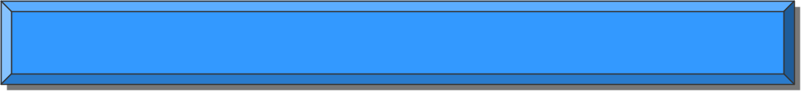
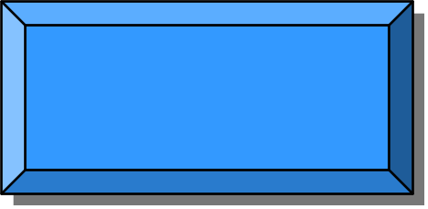
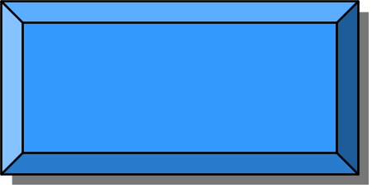
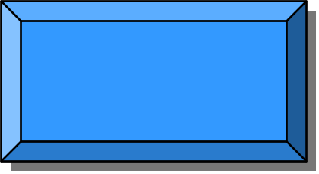
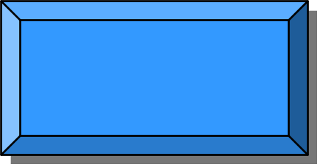
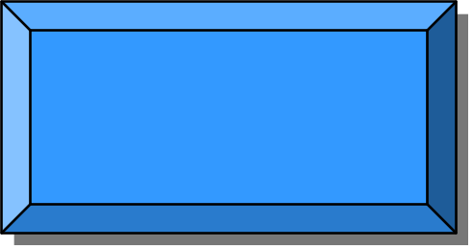


Factors Affecting Consumer Behavior: Personal
Personal Influences
Age and Life
Cycle Stage
Occupation
Economic
Situation
Personality &
Self-Concept
Lifestyle Identification
Activities
Interests
Opinions

Slide 15



SRI Values and Lifestyles (VALS) (Fig. 5.3)
Actualizers
High Resources
High Innovation
Fulfilleds
Achievers
Experiencers
Believers
Strivers
Makers
Strugglers
Low Resources
Low Innovation

Slide 16





Factors Affecting Consumer Behavior: Psychological
Motivation
Psychological
Factors Affecting
Buyers
Choices
Beliefs and
Attitudes
Perception
Learning

Slide 17


Maslow’s Hierarchy of Needs
(Fig. 5.4) (Motivational Theory)
Self
Actualization
Esteem Needs (self-esteem)
Social Needs (sense of belonging, love)
Safety Needs
(security, protection)
Physiological Needs
(hunger, thirst)

Slide 18
Physiological….
Maslow’s Hierarchy of Needs…
Products:
  Limited in the United States. Generic foods, medicines, special drinks, and foods for athletes
Specific themes:
  Campbell’s Soup - “Soup is good food,” with advertising copy that stresses the nutritional benefits of soup
  Raisins - “Thank goodness I found a snack kids will sit for. And mothers will stand for.”

Slide 19
Safety….
Maslow’s Hierarchy of Needs…
Products:
  Smoke detectors, preventive medicines, insurance, social security, seat belts, safes
Specific themes:
  Sleep Safe - “We’ve designed a travel alarm that might wake you in the middle of the night… You see, ours is a smoke alarm as well as an alarm clock”
  Alka Seltzer - “Will it be there when you need it?”

Slide 20
Social/Belongingness…
Maslow’s Hierarchy of Needs…
Products:
  Personal grooming, foods, entertainment, clothing, and many others.
Specific themes:
  Oil of Olay - “When was the last time you and your husband met for lunch?”

Slide 21
Esteem…
Maslow’s Hierarchy of Needs…
Products:
  Clothing, furniture, liquors, hobbies, stores, cars, and many others
Specific themes:
  Sheaffer - “Your hand should look as contemporary as the rest of you”
  St. Pauli Girl - “People who know the difference in fine things know the difference between imported beer and St. Pauli Girl

Slide 22
Self-Actualization…
Maslow’s Hierarchy of Needs…
Products:
  Education, hobbies, sports, some vacations, gourmet foods, museums
Specific themes:
  U.S. Army - “Be all you can be”
  U.S. Home - “Make the rest of your life… the best of your life”, Surf Excel (dag theke darun kisu)

Slide 23
Types of Buying Decision Behavior (Fig. 5.5)
High
Involvement
Low
Involvement
Significant
differences
between
brands
Complex
Buying
Behavior
Variety-
Seeking
Behavior
Few
differences
between
brands
Dissonance-
Reducing Buying
Behavior
Habitual
Buying
Behavior

Slide 24
Types of Buying Decision Behavior
High
Involvement
Low
Involvement
Complex Buying
Behavior: PC/Laptop
Expensive, risky,
Purchased infrequent and highly
self expressive. Learning, beliefs,
attitudes, and making a thoughtful
purchase choice. Salespeople
should influence the
final brand choice.
Variety-Seeking
Behavior: Cookie purchase.
Do a lot of brand switching.
First hold a belief,
choose a brand, consume and
Evaluate. Brand switch occur
For the sake of variety. Encourage
through lower price,
coupons, free samples and
advertising.
Significant
differences
between
brands
Dissonance-
Reducing Buying
Behavior: Carpet buying.
Expensive, risky and
Infrequent purchase
and post purchase
communication can reduce
this
Habitual Buying
Behavior: Salt purchase.
Passively received information
through TV and magazine
to create brand familiarity.
Passive learning through
Purchase and may not followed
Evaluation. Price and sales
Promotions to enhance trial.
Few
differences
between
brands

Slide 25
High versus Low Involvement…
High Involvement purchase occasions can be
1. expensive, have serious personal consequences,
2. and/or reflect one’s social image.
3. These occasions typically involve extensive information search, consideration of several product attributes and brands, the formation of attitudes, and word-of-mouth communication.
4. An example would be the purchase of an automobile or stereo system.
5. extensive promotion to target market and good advertisement

Slide 26
High versus Low Involvement…
Low Involvement purchase occasions typically involve
1. little information search
2. or consideration of various brands, except on the basis of price.
3. They usually don’t involve any personal consequences. They tend to be privately consumed.
4. An example would be the purchase of soap or
toothpaste.
5. In-store promotion and eye-catching package design

Slide 27
Buyer Decision Process
(Fig. 5.6)
Purchase
Decision
Evaluation
of Alternatives
Post purchase
Behavior
Information
Search
Need Recognition

Slide 28


Buyer Decision Process
Step 1. Need Recognition
Buyer Recognizes a Problem or a Need.
Needs Arising From:
Internal Stimuli –
Hunger
External Stimuli-
Friends
State Where the Buyer’s Needs are Fulfilled and the Buyer is Satisfied.

Slide 29
The Buyer Decision Process
Step 2. Information Search
Personal Sources
Commercial Sources
Public Sources
Family, friends, neighbors
Most effective source of
information
Experiential Sources
Advertising, salespeople
Receives most information from
these sources
Mass Media
Consumer-rating groups
Handling the product
Examining the product
Using the product

Slide 30
The Buyer Decision Process
Step 3. Evaluation of Alternatives
Consumer May Use Careful
Calculations & Logical Thinking
Consumers May Buy on Impulse and
Rely on Intuition
Consumers May Make Buying Decisions
on Their Own.
Consumers May Make Buying Decisions
Only After Consulting Others.
Marketers Must Study Buyers to Find Out How They Evaluate Brand Alternatives

Slide 31
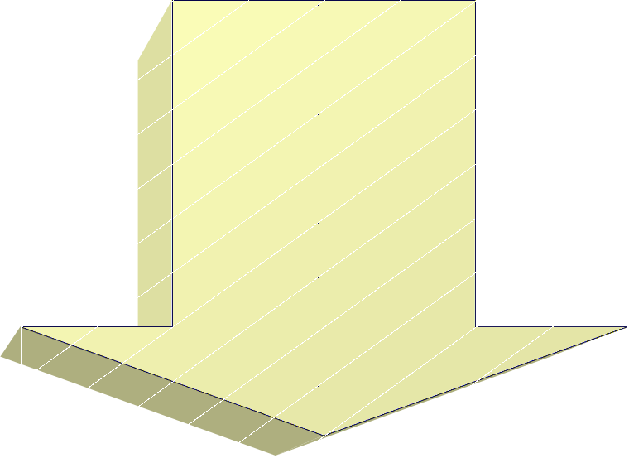
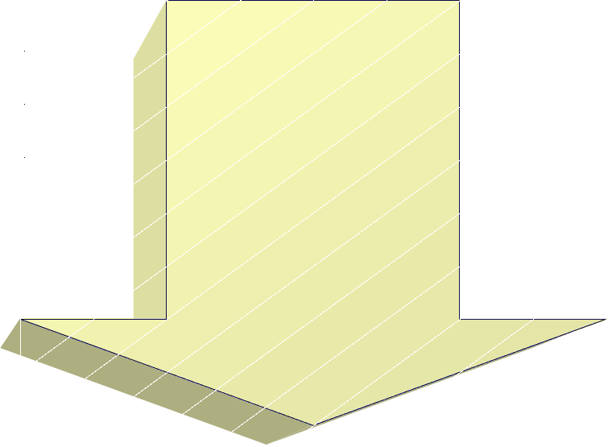
The Buyer Decision Process
Step 4. Purchase Decision
Purchase Intention
Desire to buy the most preferred brand
Attitudes of Others
Unexpected Situational Factors
Purchase Decision

Slide 32

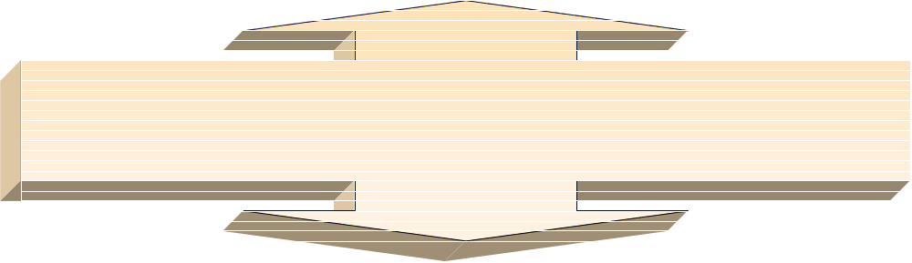

The Buyer Decision Process
Step 5. Post purchase Behavior
Satisfied Customer!
Consumer’s
Expectations of Product’s Performance.
Product’s Perceived
Performance.
Dissatisfied Customer
Cognitive Dissonance

Slide 33

Discussion Connections
Form small groups to discuss a specific major purchase that one of you has made recently.
  What type of buying decision was it? (slide #12)
  Discuss the Buyer Decision Process and what major factors influenced your decisions.

Slide 34
Stages in the Adoption Process
Awareness: Consumer is aware of
product, but lacks information.
Interest: Consumer seeks
Information about new product.
Evaluation: Consumer considers
trying new product.
Trial: Consumer tries new
product on a small scale.
Adoption: Consumer decides to make regular use of product.

Slide 35
Adopter Categories (Fig. 5.7)
Early Majority
Late Majority
Innovators
Early
Adopters
Percentage of Adopters
34%
34%
Laggards
13.5%
16%
2.5%
Time of Adoption
Early
Late

Slide 36
Influence of Product Characteristics on Rate of Adoption
Communicability
Can results be easily
observed or described
to others?
Relative Advantage
Is the innovation
superior to existing
products?
Divisibility
Can the innovation
be used on a
trial basis?
Compatibility
Does the innovation
fit the values and
experience of the
target market?
Complexity
Is the innovation
difficult to
understand or use?

